Slide 1
VPE SYSTEM Migration
Chiyoda Philippines Corporation
Technical and Commercial Study
• Arnel R. Valondo (Project Lead)
• Christian B. Alviar (Asst. Lead)
• Aldon D. Jimenez (Technical Support Member)
DII- Project Support DX Department
October 23, 2023

Slide 2
General Outline (Objective)
The purpose of this project is to migrate/relocate all data, configurations and settings of VPE system.
VPE System was currently deployed on CPH64, which had an issue related to security risk regarding its outdated OS and Vulnerability Assessment.
Maintain web application’s functionalities.
Explore for future enhancements/upgrade.
Main objective of this study is to address the process and output requirements of Procurement Department (PRC) when creating a new Vendor Performance Evaluation (VPE) System in the most cost-effective approach utilizing the given available resources.

Slide 3
PRC Requirement
Objective: Automate the Vendor’s Performance Evaluation.
Target Output
1. Individual Vendor Evaluation
2. Semi-Annual Vendor Performance Evaluation Summary
3. Annual Vendor performance Evaluation Summary
4 .Report in pdf file or excel file.
Frequency of Usage: Twice a year
Importance of VPE:
1. Monitor, measure, and evaluate performance of vendor
2. Mitigate vendor’s poor performance
3. Continuous improvement
4. ISO compliance

Slide 4
Old VPE System
A. VPE System (Current Setup / Background)
HARDWARE | SOFTWARE | MAN-POWER | MAN-HOUR
Physical Server (CPH64) • CPU: Xeon @ 2.4 GHz • RAM: 16 GB • HDD: 1 TB | SQL Server Management Studio PostgreSQL Visual Studio Code | 1 Person (Developer already resigned) | ??? (Data unavailable)
Current Issues:
• Operating System (Windows Server 2012) is End-of-Life (EOL) in October 2023.
• Vulnerability Assessment: 1. SSL Certificate Signed Using Weak Hashing Algorithm;
2. JQuery 1.2 < 3.5.0 Multiple XSS
• CPH64 Years of Service: 8.5 years (candidate for decommissioning)

Slide 5
New VPE System (Study Proposal)
B. New VPE System Requirement
Initial Plan
HARDWARE | SOFTWARE | MAN-POWER | MAN-HOUR
Virtual Server (New) • Capacity Storage (Database): 10 GB | OS: MS Windows Server 2019 Database: PostgreSQL Application Tools: Visual Studio Code Heidi SQL Python (modules) | Approximately 2-3 people | Approximately 180 MH
* All listed requirements are subject to change depending upon the request from PRC Department and future enhancements.

Slide 6
Host Machine Comparison
Hardware Requirement
Criteria | PHYSICAL SERVER | VM SERVER
Performance
Security
Portability
Cost Efficient
NOTE 2
NOTE 1
NOTE 1: Plan to use an existing/available physical server as new host, replacing CPH64 server.
NOTE 2: Plan to create a new virtualized server (VM) dedicated to host the new VPE System.

Slide 7
Database Comparison
Software Requirement (Database)
 | SQL SERVER | POSTGRE SQL | SQL SERVER EXPRESS
License | Both commercial and freeware editions are available | Freeware Edition | Freeware Edition
Operating System | Windows Server 2022 Standard, Windows Server 2019 Standard, Windows Server 2016 Standard, etc.. | Cross-platform | Windows Server 2022 Standard, Windows Server 2019 Standard, Windows Server 2016 Standard, etc..
NOTE 1
NOTE 1: Some notable limitations of SQL Server Express version are the following:
1. Maximum database size of 10 GB.
2. Maximum 1410 MB of memory.
3. Maximum compute of 1 socket or 4 cores.
4. No support for Always On.
5. No support for SQL Job Agent.
6. No support for SQL Analysis Services.
7. No SQL Integration Services.

Slide 8
Applications Comparison
Software Requirement (Software Tools)
Identifier | Visual Studio Code | Heidi SQL / SSMS | Python
Purpose | Code Editor | Primarily use for database operations | Scripting/ Backend Operations
Licensing | Not Required | Not Required | Not Required
Cost | Free Version | Free Version | Free Version
NOTE 1
NOTE 1: SQL Server Management Studio (SSMS).

Slide 9
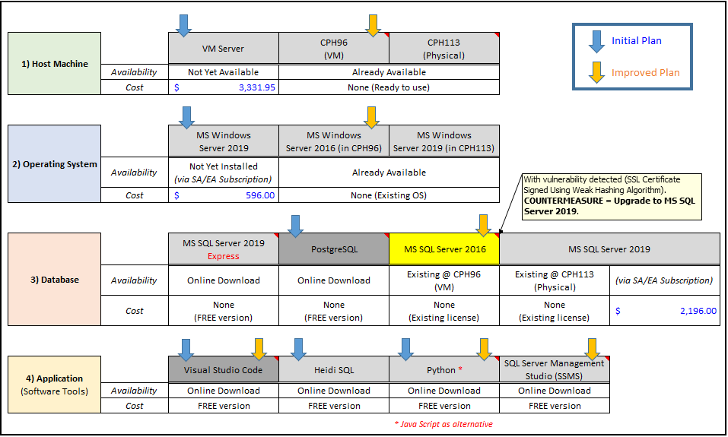
Cost Comparison

Slide 10
Summary
The development team choose to use Python as the backend tool for scripting as they are more familiar on Python code than ASP.net core and C# scripting. Python has also modules for developing web applications such as Django, Flask, Numpy, Web2py.. Etc. Python also support different tools for data manipulations to meet the required output. Web deployment is also supported using WSGI settings.
All technical resources (HW, SW, MP, MH) have been found available.
Alternative costs have been reviewed.
PRC requirements have been studied.
Timeline and schedule of activities have been outlined.
Economical approach has been considered.

Slide 11
Conclusion and Recommendation
We therefore conclude that Python (as the main scripting tool) can be used to re-model/re-create the Vendor Performance Evaluation (VPE) system and re-deploy it on the new server. However, change in software tools/language should also be considered depending on the (current) developer’s requirement.
That after series of review from initial plan to improved plan, we can conclude and say that:
For cost effective way of migrating the VPE System, it is hereby recommended to use an existing virtualized (VM) server (CPH96) having Windows Server 2016 as Operating System. Its existing database software (SQL Server 2016) should be upgraded to version 2019. Utilize Visual Studio Code, Python, and SSMS as the application software tools.

Slide 12
Thank You

